Slide 1

Towards a corporate digital responsibility (CDR) reporting framework
56 WCARS Madrid, April 27, 2023
Enrique Bonsón
Universidad de Huelva. Observatorio BIDA, AECA
Michaela Bednárová
Universidad Pablo de Olavide. Comisión NT, AECA

Slide 2
Agenda
Introduction
CDR scope and definition
Our previous research
CDR reporting framework

Slide 3
Introduction
CDR scope and definition
Our previous research
CDR reporting framework
Introduction
Over the last decade we have been witnessing how new technologies such as AI, automation, or ADM algorithms increase efficiency in production processes, marketing, HR, etc.
At the same time, they give rise to some ethical questions related to data protection, cybersecurity, safety, human rights, etc.
ADM - automated decision making algorithms are of particular concern.
Possible threats of ADM without human supervision are real.

Slide 4
Introduction
CDR scope and definition
Our previous research
CDR reporting framework
Introduction
Stanislav Yevgrafovich Petrov and 1983 Soviet nuclear false alarm incident
Although this is not an example of ADM, because there was a protocol to be followed instead of automation (human final decision) – imagine that this would be left to ADM without human supervision to decide.
Petrov was a lieutenant colonel of the Soviet Air Defence Forces who ignored automated warning. On 26 September 1983, Petrov was the duty officer at the command center for the Oko nuclear early-warning system when the system reported that a missile had been launched from the United States followed by up to five more. Petrov judged the reports to be a false alarm. His subsequent decision to disobey orders, against Soviet military protocol, is credited with having prevented an erroneous retaliatory nuclear attack on the United States and its NATO. An investigation later confirmed that the Soviet satellite warning system had indeed malfunctioned.
Because of his decision not to launch a retaliatory nuclear strike amid this incident, Petrov is often credited as having "saved the world".
Notes:
Russian man who ignored automated warning (Stanislav Yevgrafovich Petrov was a lieutenant colonel of the Soviet Air Defence Forces who played a key role in the 1983 Soviet nuclear false alarm incident.^{[1]} On 26 September 1983, three weeks after the Soviet military had shot down Korean Air Lines Flight 007, Petrov was the duty officer at the command center for the Oko nuclear early-warning system when the system reported that a missile had been launched from the United States, followed by up to five more. Petrov judged the reports to be a false alarm.^{[2]} His subsequent decision to disobey orders, against Soviet military protocol,^{[3]} is credited with having prevented an erroneous retaliatory nuclear attack on the United States and its NATO allies that could have resulted in a large-scale nuclear war which could have wiped out half of the population of the countries involved. An investigation later confirmed that the Soviet satellite warning system had indeed malfunctioned. Because of his decision not to launch a retaliatory nuclear strike amid this incident, Petrov is often credited as having "saved the world".^{[4][5][6]}

Slide 5

Introduction
CDR scope and definition
Our previous research
CDR reporting framework
Introduction
Less extreme cases – Amazon´s biased algorithms hiring more men than women
AI and automation certainly brings higher efficiency, but also increase ethical concerns such as discrimination and others.

Slide 6
Introduction
CDR scope and definition
Our previous research
CDR reporting framework
CDR scope and definition
While CSR aimed to address environmental and social challenges (we have developed GRI, SDGs, etc.), nowadays we are facing new threats that should be addressed accordingly. New threats - new responsibilities - CDR
What are we doing in this regard? On one hand, there is a voluntary disclosure and the pressure also led to initiatives related to AI ethics and even a proposal for AI regulation.
Observing the voluntary CDR reporting, a question arises – what is the scope of CDR?
It is as wide as moving from online shopping trying to decrease waste and carbon print to digital literacy and fighting against cyberbullying.

Slide 7
Introduction
CDR scope and definition
Our previous research
CDR reporting framework
CDR definitions
“ … a voluntary corporate orientation to ensure a responsible use of digital technologies.” Weißenberger and Marrocco (2022)
‘‘ … a set of shared values and norms guiding an organization’s operations with respect to the creation and operation of digital technology and data.’’ Lobschat et al. (2021)
“ … an extension of a firm’s responsibilities which takes into account the ethical opportunities and challenges of digitalization.” Herden et al. (2021)
“ … a set of practices and behaviors that help an organization use data and digital technologies in a way that is socially, economically, and environmentally responsible.” Wade (2020)
Notes:
We also analyzed the literature looking for definitions of CDR

Slide 8
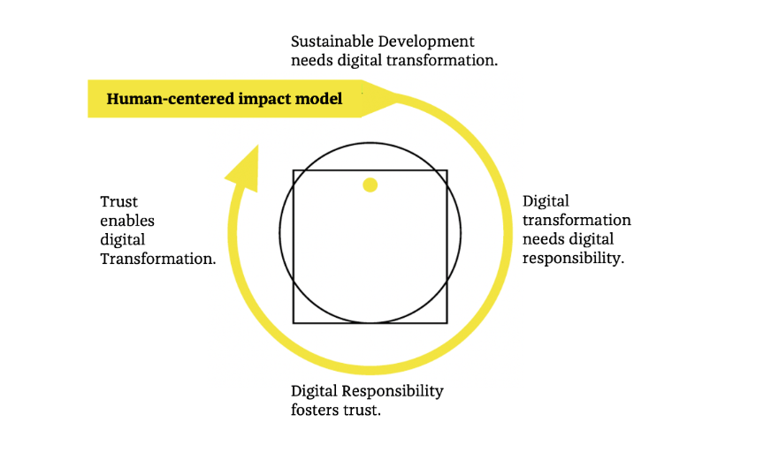
Introduction
CDR scope and definition
Our previous research
CDR reporting framework
The need for digital responsibility. (Source: identityvalley.org)

Slide 9
Introduction
CDR scope and definition
Our previous research
CDR reporting framework
From principles and regulations to disclosures
Assurance
Principles
Requirements
CDR
(ADMs, AI, Cyber-security, Privacy, etc..)
Regulations
Disclosures
Notes:
Currently, the companies are voluntarily disclosing on CDR and its aspects such as AI, cybersecuity, ADM, privacy. According to legitimacy theory they try to legitimate thei activities and show that their actions are in compliance with the society norms,
They might follow some principles such as EU principles for trrustworthy AI or others.
However there is no regulation on how to report on CDR and no assurrance on such disclosue is required. Because it is still an evolving área.
So the main objective of our research is to contribute to this evolving área by proposing a CDR reporting framewok.
Wich would clealy define what is the scope of CDR and how the Company should report on it.

Slide 10
Introduction
CDR scope and definition
Our previous research
CDR reporting framework
Disclosures
The ethical (and legal) use of digital technologies will lead companies to a greater focus on corporate digital responsibility and, consequently, to an increase in voluntary disclosures of related topics to legitimize their digital responsibility actions.
Examples:
1. Artificial intelligence activities and ethical approaches in leading listed companies in the European Union (Bonsón, Lavorato, Lamboglia, Mancini, IJAIS, 2021).
2. Voluntary disclosure on algorithmic decision-making systems: European evidence (Bonsón, Bednárová, Perea, IJAIS, 2023).
3. Data protection policies and governance models in European companies’ corporate reports (Bonsón, Cruz, Perea, working paper, 2023).

Slide 11
Introduction
CDR scope and definition
Our previous research
CDR reporting framework
The need for standardization in such disclosures
1. The study provides evidence of AI disclosure, a type of non-financial disclosure that has not been explored yet in the literature. Unlike existing studies, we propose a first definition of the topic and a taxonomy that can be used in further research on CDR disclosure and can contribute to the development of KPIs in the field.
2. ADM disclosure (an important part of CDR) is rather scarce and still at a preliminary stage. Only a few Western European companies disclosed information related to ADM in their annual/sustainability reports in the years investigated. In total, there were 28 mentions. Indeed, no company reported its compliance with certain standards regarding ADM usage.
3. We confirm the lack of standardization in data protection disclosures

Slide 12
Introduction
CDR scope and definition
Our previous research
CDR reporting framework
Companies disclosing about CDR in their A/S reports
Sample: 403 reports (year 2021) from major listed companies (346) in 13 western Europe countries
Methodology: Text mining
Findings: 8 companies (Basf, Daimler, Deutsche Telekom), (Telekom Austria, Oesterr Post), (Elisa, FI), (Dassault Systemes, FR) and (Hera Group, IT)
Contents: CDR related to data protection and data security, CDR as an action area, CDR to ensure compliance with GDPR, CDR framework, CDR policy, CDR for ethical data management, digital sustainability, responsible use of AI, promoting a culture of CDR

Slide 13
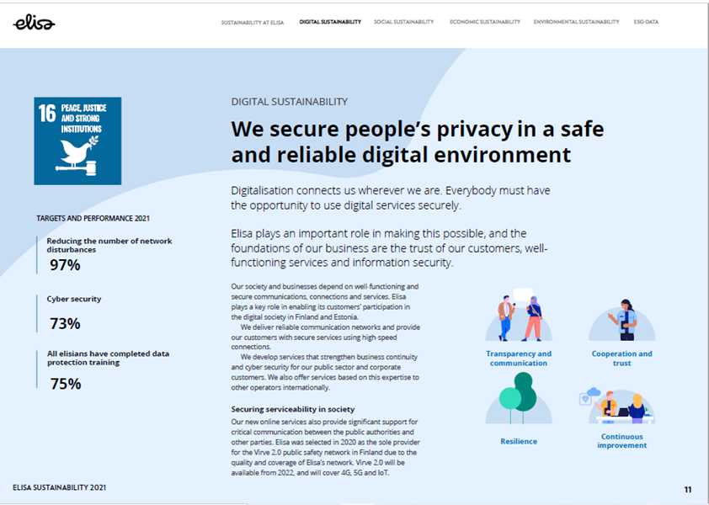
Introduction
CDR scope and definition
Our previous research
CDR reporting framework
CDR disclosures

Slide 14
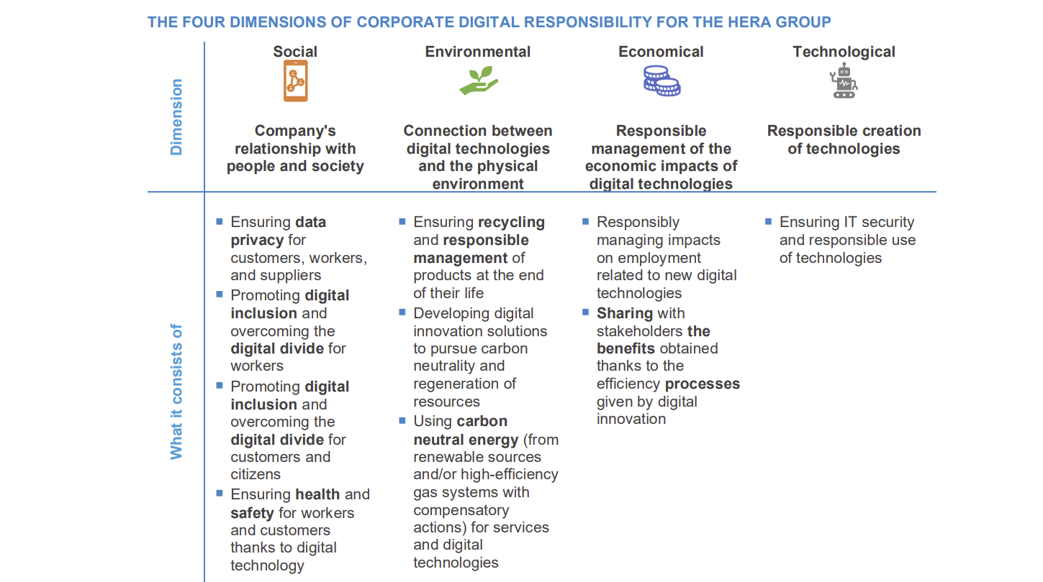
Introduction
CDR scope and definition
Our previous research
CDR reporting framework
CDR disclosures

Slide 15
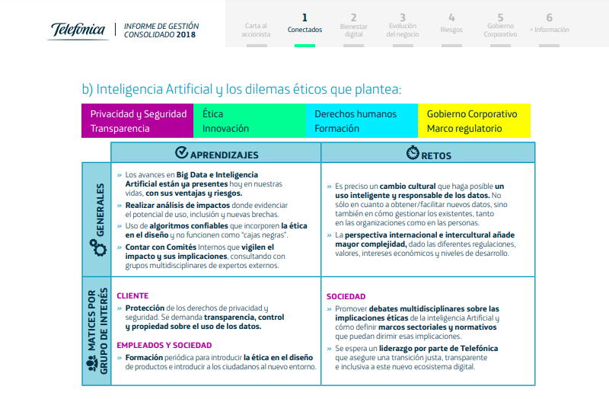
Introduction
CDR scope and definition
Our previous research
CDR reporting framework
Agenda

Slide 16
Introduction
CDR scope and definition
Our previous research
CDR reporting framework
CDR reporting framework
Methods
Inputs:
Analysing voluntary CDR reporting in Western European companies
Exploring German CDR code and reporting practices of companies
Exploring Digital Responsibility Goals
Exploring Principles of Canada’s Digital Charter Trust
Exploring Principles from the EU trustworthy AI
First draft:
Elements from above mentioned sources were compared, contrasted, organized into a final set of proposed elements.
The proposed elements were sent for validation via questionnaire (adopting international multistakeholder approach)
Final proposal
Notes:
To identify the scope of CDR we combined our findings from voluntary disclosure of companies, initiatives such as German initiative, principles (Canadian, EU), proposal for regulation…

Slide 17
Introduction
CDR scope and definition
Our previous research
CDR reporting framework
CDR reporting framework
Corporate approach to digital responsibility and E²SG
Digital-related risks
Specific disclosures and KPIs for digital sustainability matters to be covered:
Cybersecurity
Data protection and privacy
Trustworthy algorithms and data fairness

Slide 18
Introduction
CDR scope and definition
Our previous research
CDR reporting framework
CDR reporting framework

Slide 19
Introduction
CDR scope and definition
Our previous research
CDR reporting framework
CDR reporting framework

Slide 20
Introduction
CDR scope and definition
Our previous research
CDR reporting framework
CDR reporting framework

Slide 21
Introduction
CDR scope and definition
Our previous research
CDR reporting framework
CDR reporting framework

Slide 22
Thank you for your attention

